Slide 1

Fully Automated Methods for the Detection and Segmentation of Mitochondria in Microscopy Images
Blessing Ojeme Frederick Quinn
Shannon Quinn Russell Karls
Department of Computer Science, UGA Department of Infectious Diseases, UGA

Slide 2
Goal of the study
To utilize information about the shape and sophisticated background knowledge of mitochondrial structure and create a simplified mitochondrial image analysis method

Slide 3
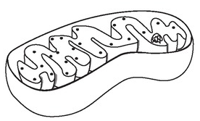
Mitochondria
Mitochondria are important intracellular organelles found in large numbers in most cells in the human body.
It is responsible for several metabolic pathways including the production of free energy and the regulation of cellular life and death.
mitochondrial dysfunction has been linked to several neurodegenerative diseases relating to aging, including Alzheimer’s disease, Huntington’s disease and juvenile-onset Parkinson’s disease, and cancer

Slide 4
Motivation
The motivation of this study originates from the need to develop a fully automated tool to detect and segment mitochondrial images without the need for a pre-trained training dataset, achieving good performance, minimum detection time, ease of implementation, and cross-platform compatibility.

Slide 5
Study contributions
Methods:
We develop a fully automated detection and segmentation model that encodes information for segmentation of 2D mitochondrial morphology from fluorescence microscopy images
Data:
We show that the proposed model enables a single workflow from data to desired detection and segmentation results without relying on pre-trained models

Slide 6
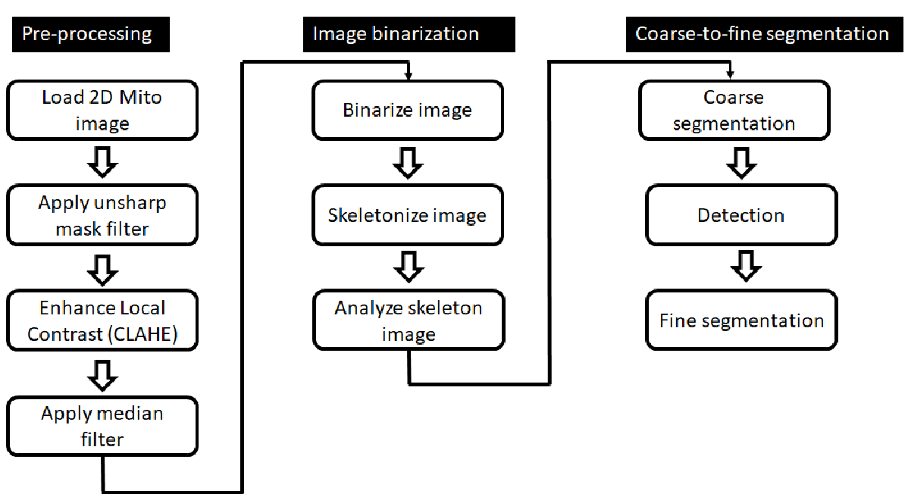
Study methodological steps

Slide 7
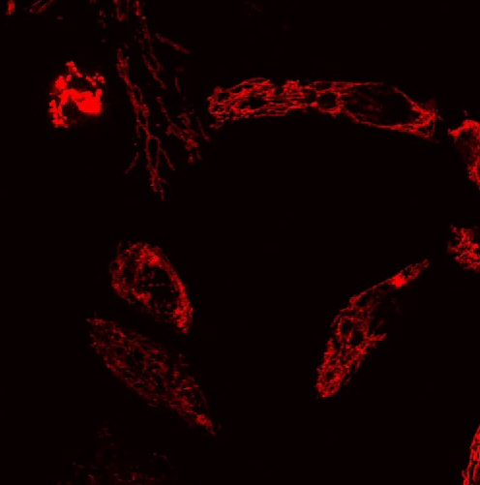
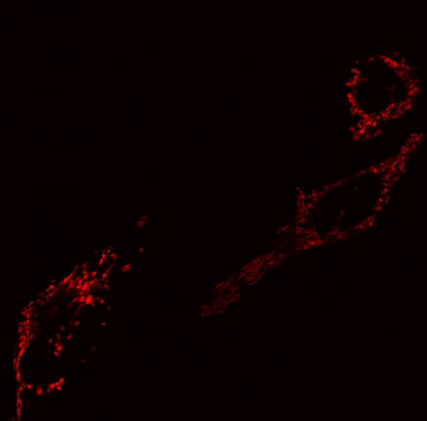
Load image
The listeriolysin O (llo) group
The mitochondrial division inhibitor 1 (mdivi) group
The control group that was not exposed to any external stimulant

Slide 8
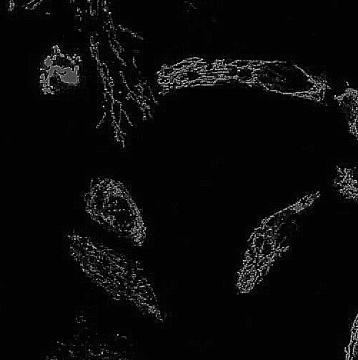
Image pre-processing (unsharp mask)
Improves the sharpness of the edges and interfaces of images containing depth information.
The opencv library achieves the unsharp mask function using the cv2.GaussianBlur and cv2.addWeighted

Slide 9
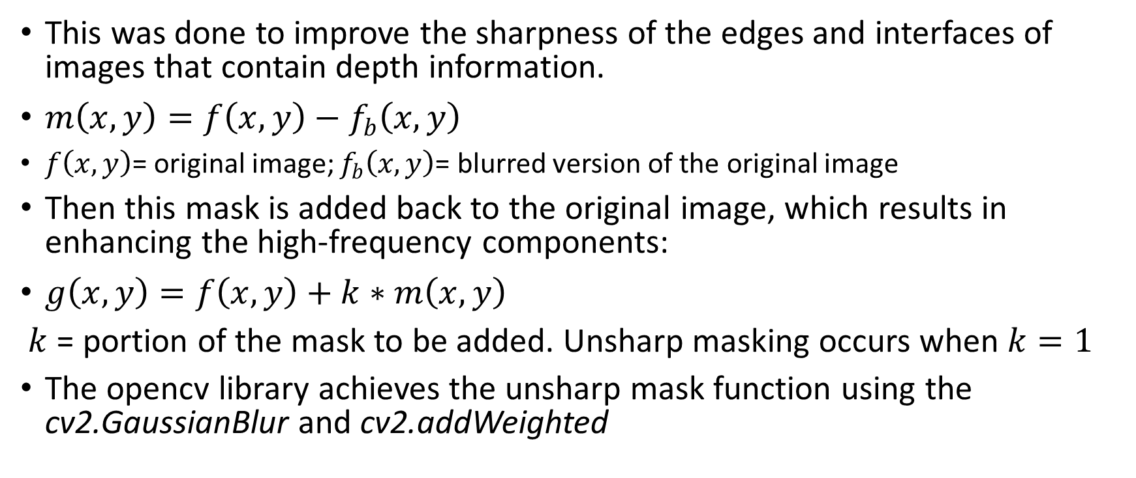
Image pre-processing (unsharp mask)
This was done to improve the sharpness of the edges and interfaces of images that contain depth information.
$m\left(x,y\right)=f\left(x,y\right)−f_{b}\left(x,y\right)$
$f\left(x,y\right)$= original image; $f_{b}\left(x,y\right)$= blurred version of the original image
Then this mask is added back to the original image, which results in enhancing the high-frequency components:
$g\left(x,y\right)=f\left(x,y\right)+k∗m\left(x,y\right)$
$k$ = portion of the mask to be added. Unsharp masking occurs when $k=1$
The opencv library achieves the unsharp mask function using the cv2.GaussianBlur and cv2.addWeighted

Slide 10
Image pre-processing (CLAHE)
(CLAHE) filter helps to improve the contrast of the images
The opencv library achieves the CLAHE using two parameters: clipLimit (representing the threshold clip size) and tileGridSize (representing the size of the image processing window).
(cv2.createCLAHE(clipLimit=2.0,tileGridSize=(gridsize,gridsize))

Slide 11
Image pre-processing (CLAHE)
contrast limited adaptive histogram equalization (CLAHE) filter is a variant of Adaptive histogram equalization (AHE), which helps to improve the contrast of the images
CLAHE function is iimplemented in the OpenCV package using two parameters: clipLimit (representing the threshold clip size) and tileGridSize (representing the size of the image processing window).
(cv2.createCLAHE(clipLimit=2.0,tileGridSize=(gridsize,gridsize))

Slide 12
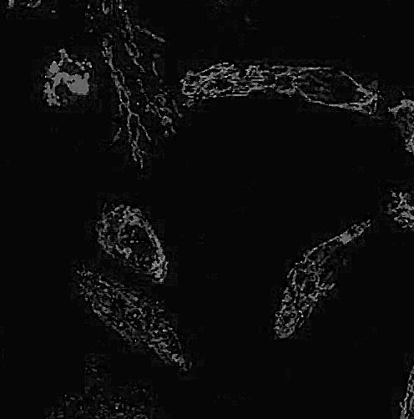
Image pre-processing (Median)
Helps to help reduce the amount of noise present in the images and preserve the edges.
Median filtering functionality is implemented in the OpenCV packages using
cv2.medianBlur() function

Slide 13
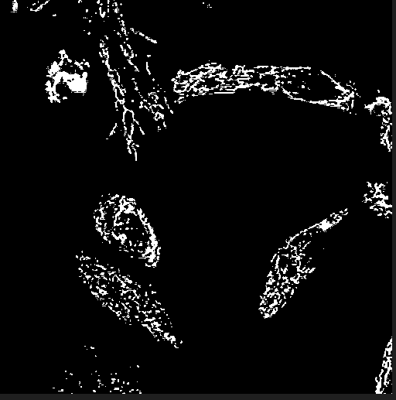
Image binarization
Thresholding T functionality helps separate the background and other non-mitochondrial tissues foreground
It is implemented in the OpenCV packages using
cv2.threshold() function.
We computed the area occupied by mitochondrial structures (footprint) from the binarized image.

Slide 14
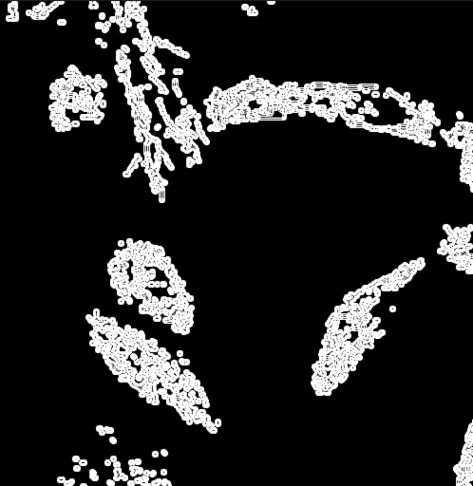
Image skeletonization
We skeletonized the image by removing small regions, and then compute the descriptive statistics (mean and standard deviation) describing the skeleton.
Skeletonized image = image topology, which is useful for feature extraction.
OpenCV provides for skeletonization process by morphology using the cv2.erode() (erosion), cv2.dilate() (dilation) and cv2.subtract() (subtraction) functions

Slide 15
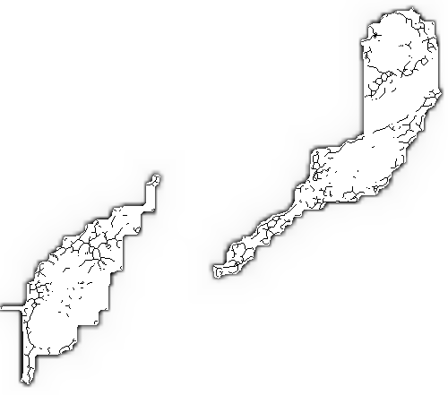
Coarse segmentation
We applied a combination of gradient boundary enhancement to achieve the coarse segmentation for small regions of mitochondria in order to identify and
include regions of high concentration of mitochondria based on its circular and elliptical shapes, and
exclude regions of non-mitochondria or low concentration of mitochondria

Slide 16
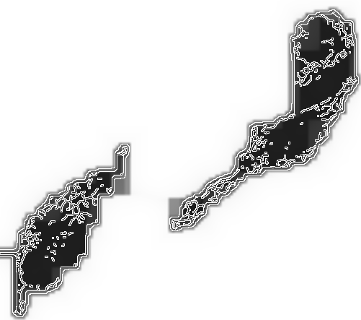
Fine segmentation
This was done by removing non-mitochondrial pixels, which touch in coarse mitochondrial regions in order to improve the segmentation of mitochondria

Slide 17
Evaluation with ground truth labels
We generated several ground truth labels from each of the three datasets using Labkit.
We paired each frame containing the mitochondria detected and segmented with the corresponding ground truth frame and computed the descriptive statistics (mean and standard deviation).

Slide 18
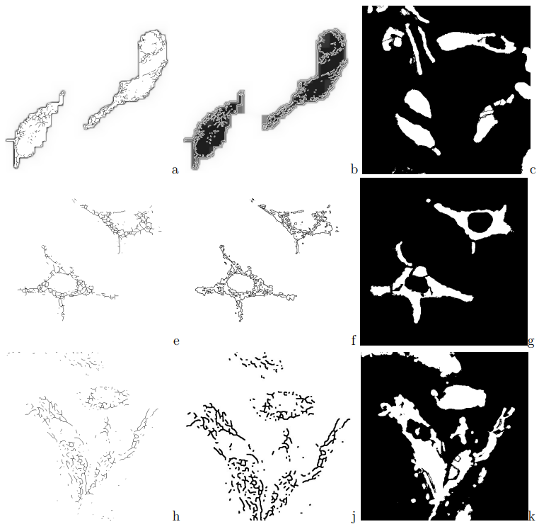
a = coarse seg-llo; b = fine seg-llo; c = GT-llo; d = coarse seg-mdivi; f = fine seg-mdivi; g = GT-mdivi; h = coarse seg-control; j = fine seg-control; k=GT-control

Slide 19
Measurement of Coarse and Fine Segmentation and Ground Truth
 | Area | Mean | Standard Deviation
Coarse segmentation for llo | 262144 | 249.317 | 30.275
Fine segmentation for llo | 262144 | 228.825 | 66.717
Ground truth for llo | 262144 | 34.496 | 87.215
Coarse segmentation for mdivi | 262144 | 3.041 | 27.68
Fine segmentation for mdivi | 6185 | 255 | 0
Ground truth for mdivi | 262144 | 22.121 | 71.775
Coarse segmentation for control | 262144 | 3.017 | 27.574
Fine segmentation for control | 247711 | 0 | 0
Ground truth for control | 262144 | 51.288 | 102.216

Slide 20
Analysis of results
The results (area, mean and standard deviation) demonstrate that all images segmented in the three datasets (llo, mdivi and control) exhibited a statistically equal area (denoting mitochondrial occupying almost an equal area) when compared with the ground truth.
This agrees with the definition of segmentation that the output from a segmentation algorithm is an image of the same dimension as the input image where each pixel has been assigned a label indicating which object class the specific pixel belongs to.

Slide 21
GitHub codes
Find our source codes on GitHub
https://github.com/quinngroup/Codes-for-ICCV-2022-paper

Slide 22
References
Lefebvre et al. (2021). Automated segmentation and tracking of mitochondria in live-cell time-lapse images
Nguyen-Thanh, et al. (2019). Automated Detection and Segmentation of Mitochondrial Images based on Gradient Enhancement and Adaptive Gabor Filter
Li et al. (2017). An automated pipeline for mitochondrial segmentation on ATUM-SEM stacks

Slide 23

Questions

